Slide 1
Block by Block
Introducing blockr, the Flexible Open-Source Dashboard Builder
OS12
Karma Tarap & John Coene
PHUSE EU CONNECT 2024
Statistical Programming - GBDS

Slide 2

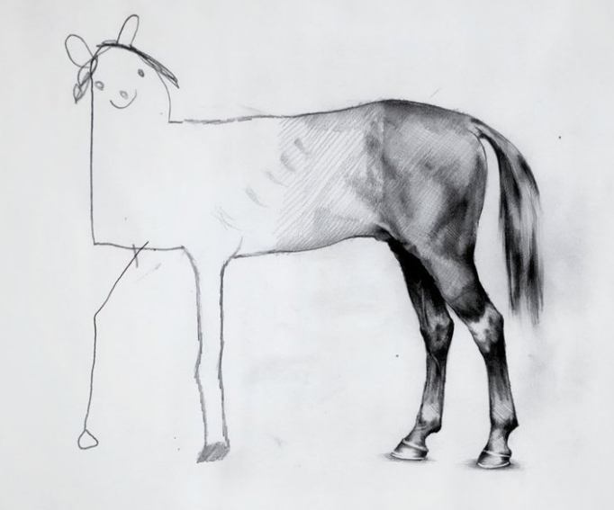
The Growing Complexity of Clinical Dashboards
“I just need a simple safety monitoring dashboard using SDTM data”
"Can merge external lab data from these CSVs?”
“Actually, efficacy is really important too”
“We want to use some plots for decision making URGENTLY”
The ONLY constant is Change!

Slide 3



The Faces of Clinical Data Analysis
The Scientist | The Statistician | The Programmer

Slide 4

The Frustrated Scientist
"I need to be able to follow where the data leads me, not where the dashboard allows me to go."

Slide 5

The Isolated Statistician
"My models are powerful, but no one else can use them without my help."

Slide 6

The Overwhelmed Programmer
"Every study needs a custom dashboard, and each clinician wants data transformed differently. I'm drowning in code maintenance and conflicting requests!"

Slide 7

Friday Afternoon
URGENT!!
Outputs from your app were used to answer HA questions and an error was found. Audit Monday! Reanalyze ALL data by Sunday 8 PM
Provide full reproducibility report. Explain ALL discrepancies
Work weekend required. Confirm receipt ASAP.
Your bosses bosses boss

Slide 8



Friday Afternoon
PANIC !!
What does reproducible even mean?
How can I prove my calculations are correct?
How am I going to extract all the code from these dashboards?

Slide 9
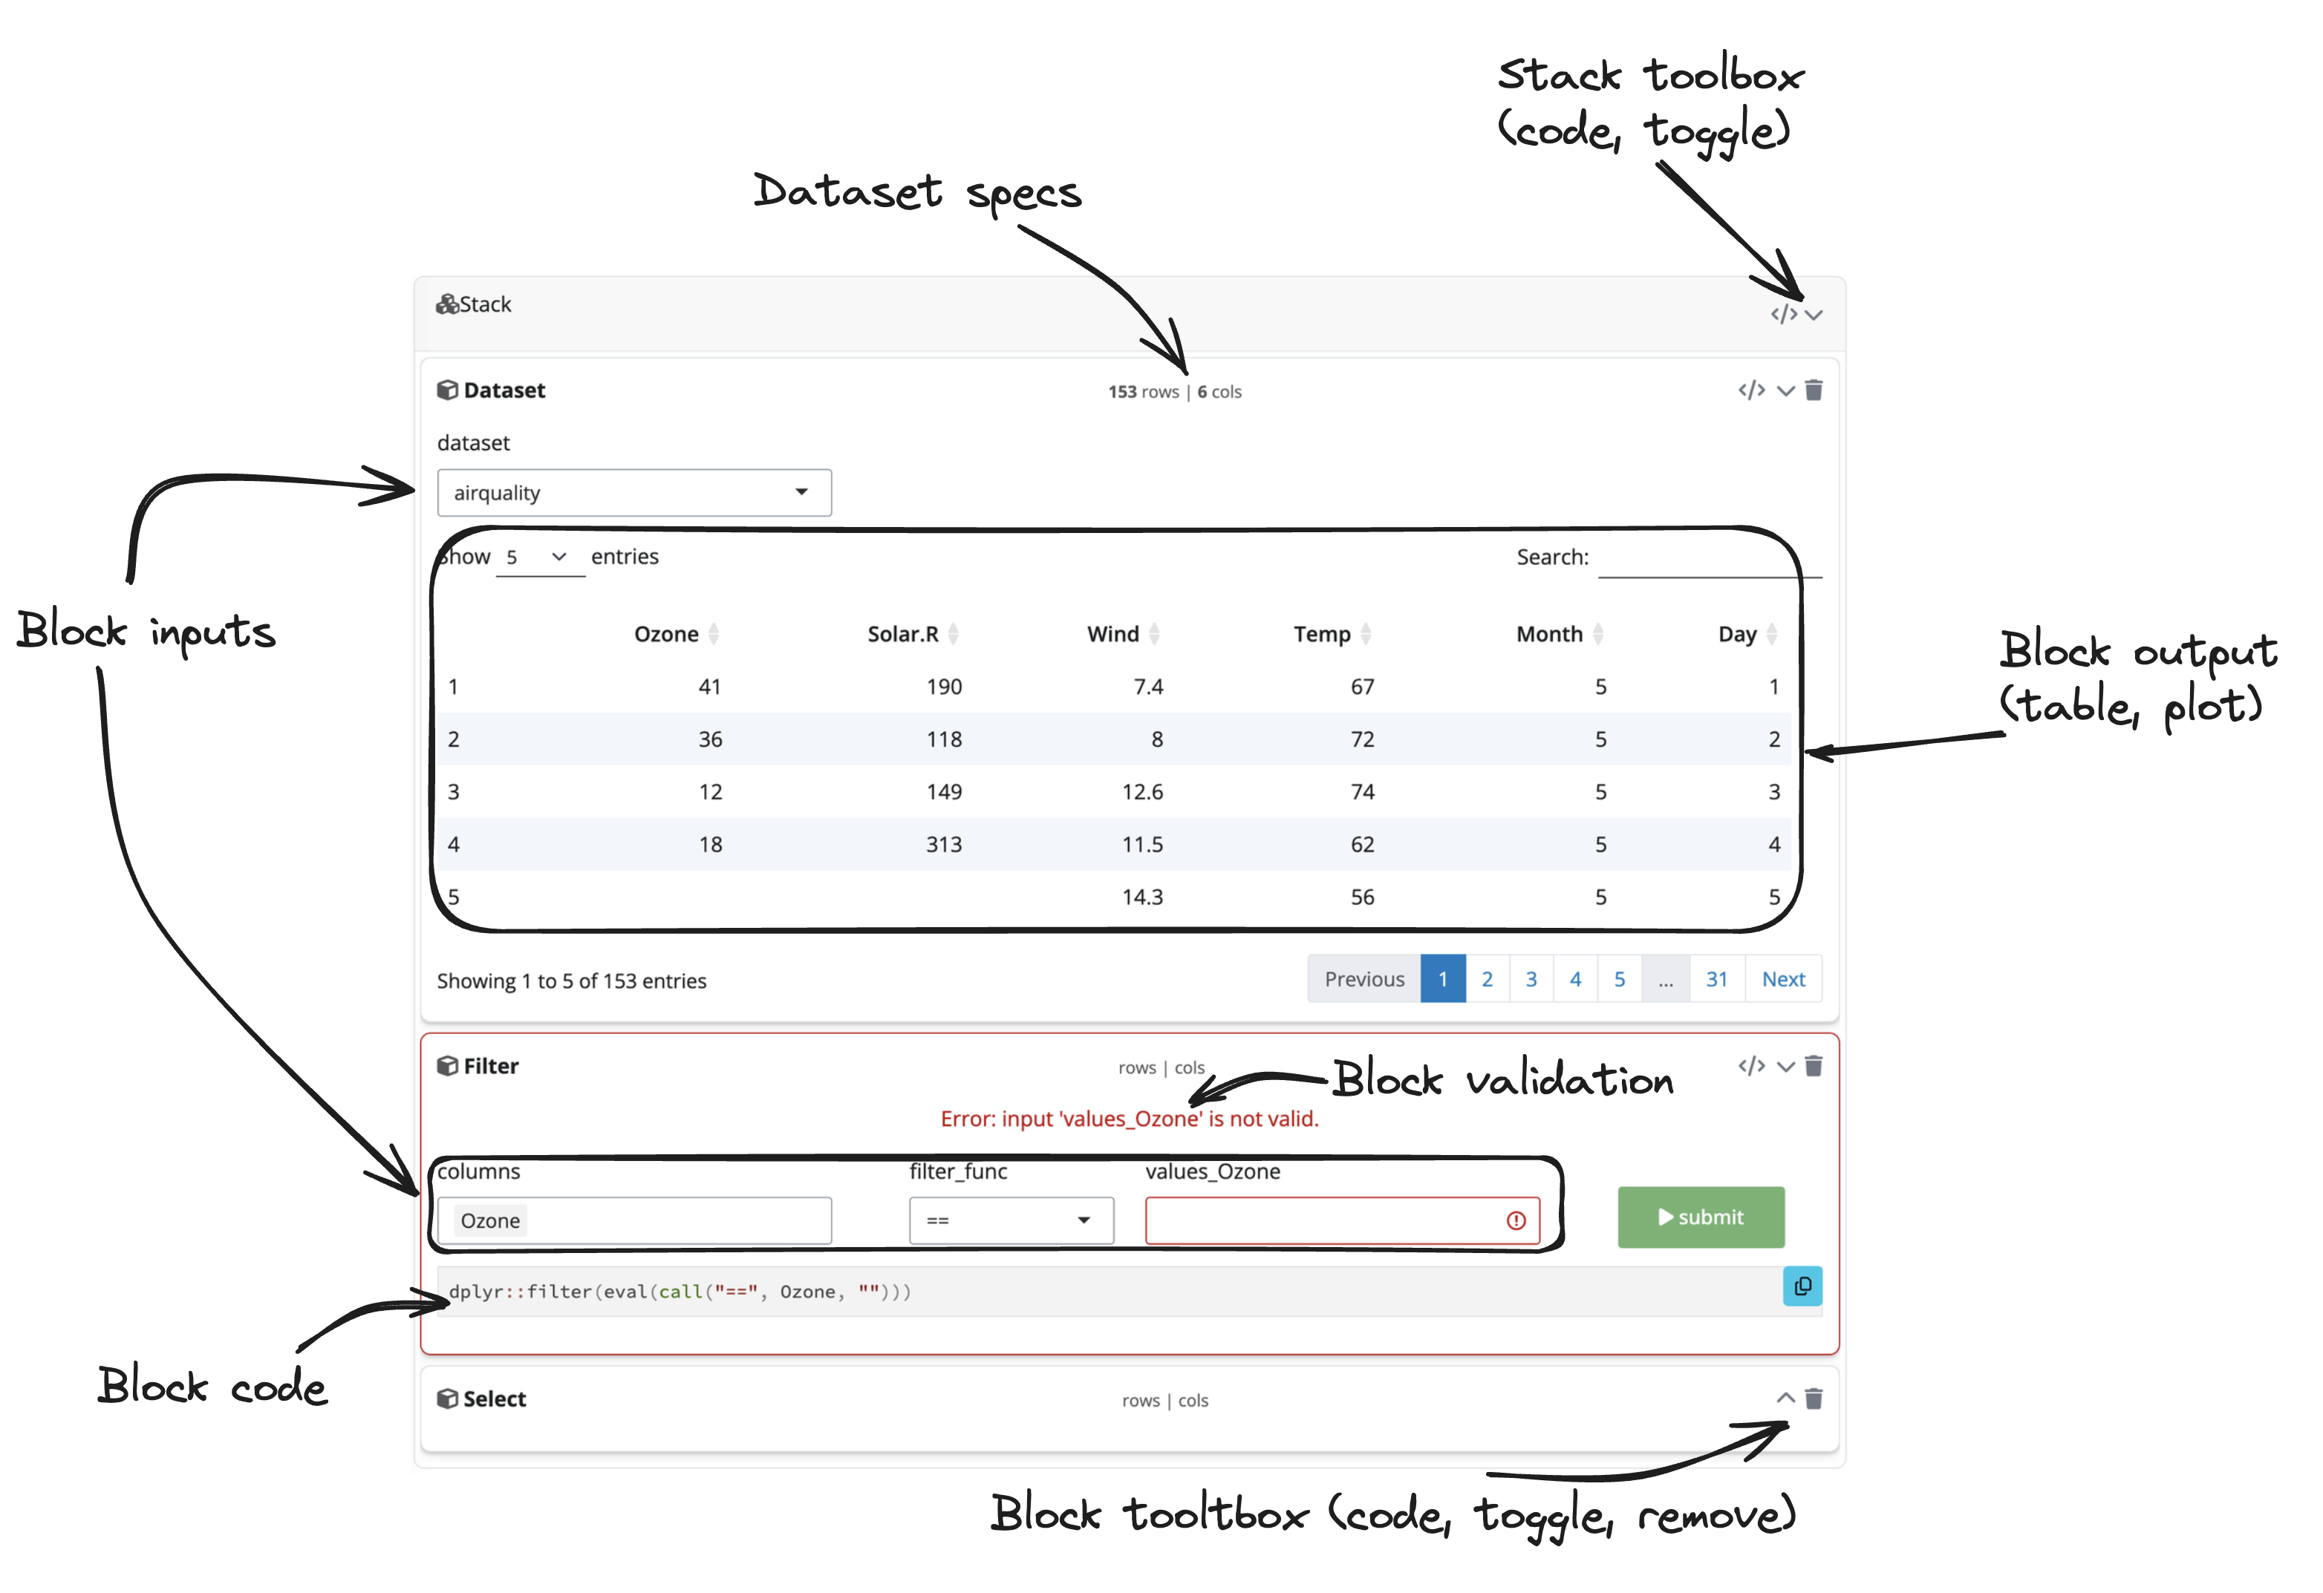
There's a Better Way: Meet blockr
{blockr} is an open-source R package designed to streamline the creation of Enterprise-grade data analysis pipelines and interactive dashboards.
Key features:
Visual, block-based interface
Modular and reusable components
Built-in reproducibility
Extensible framework

Slide 10

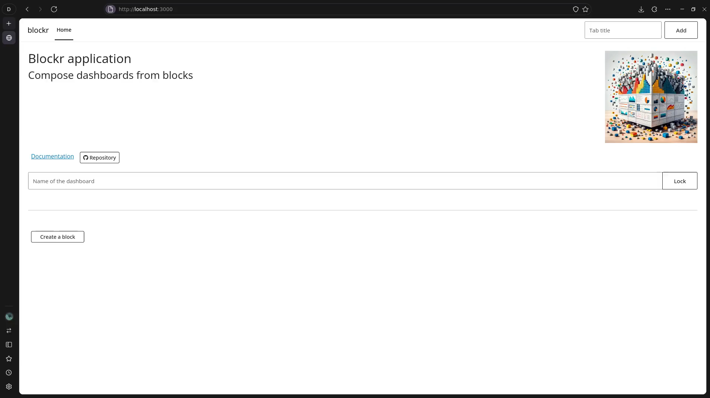
Empowering the Researcher

Slide 11

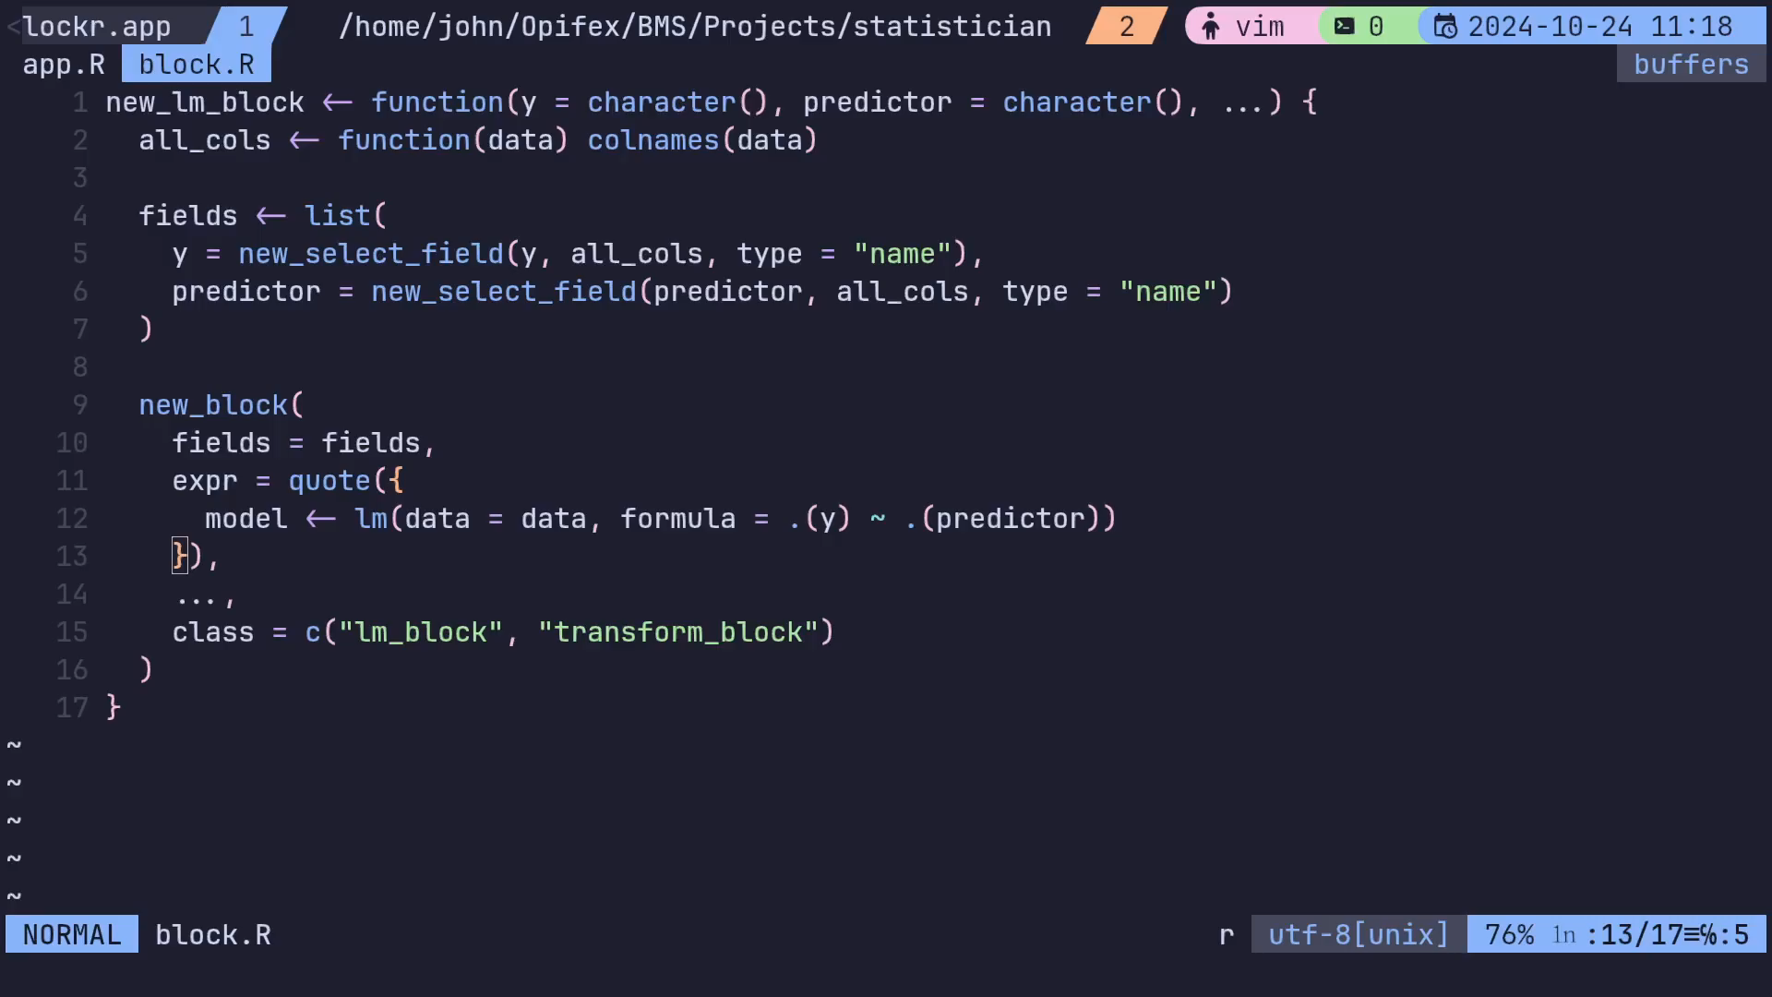
Unleashing the Statistician

Slide 12

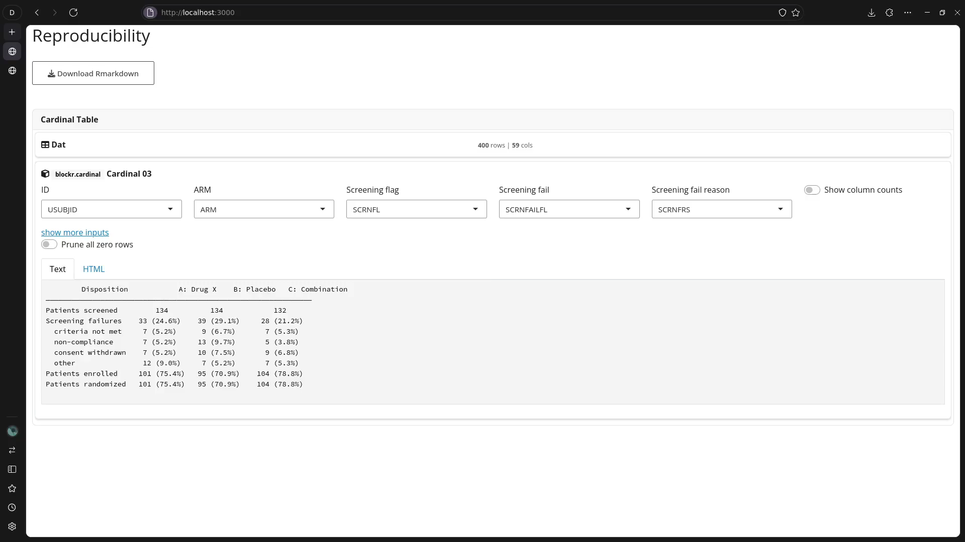
Liberating the Programmer

Slide 13
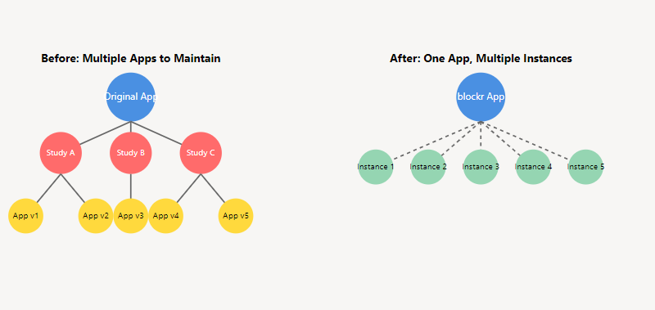
Multi-Dashboard Management

Slide 14



The Verdict
“I can answer new questions as they arise. I can also save my analysis and share them”
“I can now easily share my models with others!”
“I can finally focus on creating high-quality, reusable components!”
The Scientist | The Statistician | The Programmer

Slide 15
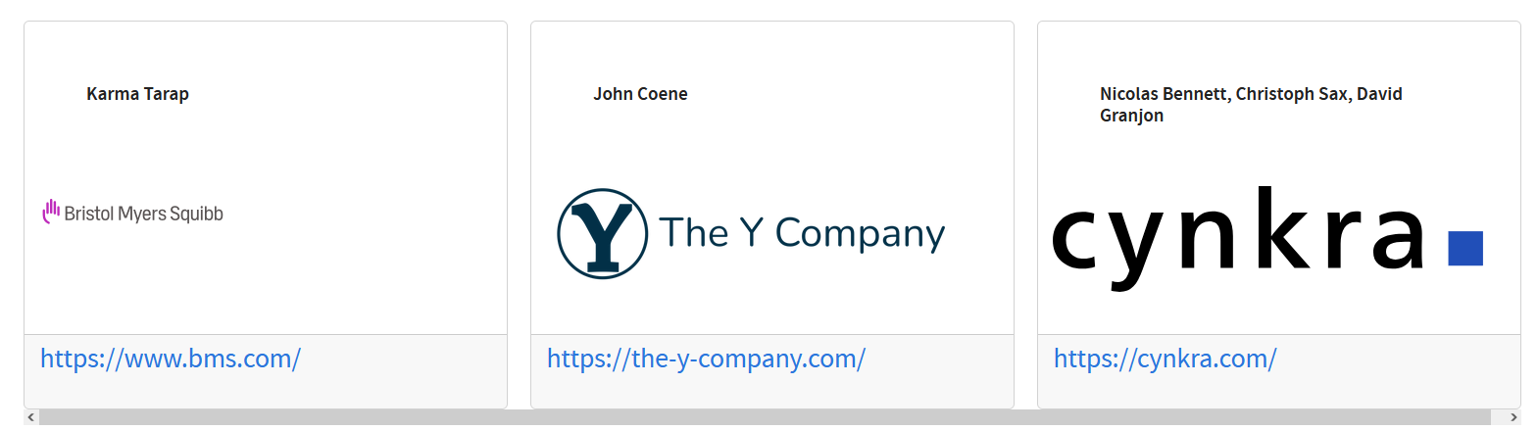
https://github.com/BristolMyersSquibb/blockr
Join the {blockr} Revolution

Slide 16

Q&A | Any questions?

